Slide 1
NPP Mission
The NROTC Preparatory Programs (NPP) Office mission is to expand NROTC opportunities to produce a more capable and representative Naval Officer Corps.
NPP supports that mission by partnering with educational institutions to enhance underserved or disadvantaged scholarship applicants' moral, mental, and physical foundations to prepare them for success in the NROTC program and a Naval career.

Slide 2
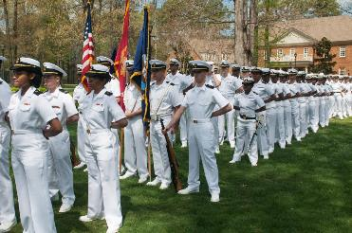
NROTC Preparatory Program (NPP)
Expand NROTC opportunities to produce a more capable and representative Naval Officer Corps.
Partner with 23 Universities in AY 23-24
1 year University funded program that can include tuition, fees, books, room and board for the preparatory year
Each school provides specific levels of funding based on local factors
Students who successfully complete the preparatory year receive a 4 year NROTC scholarship
Notes:
The NROTC Preparatory Program’s mission is to expand NROTC opportunities to underserved or disadvantaged populations to produce a more diverse, inclusive Navy officer corps.
NROTC Preparatory Program supports that mission by partnering with educational institutions to enhance underserved or disadvantaged scholarship applicants' moral, mental, and physical foundations to prepare them for success in the NROTC program.
NPP is a one-year University funded (Tuition, fees, room, and board) program. Each program is designed by the university, in partnership with the local NROTC unit, to enhance students’ mental, moral, and physical foundations to prepare them for success in academics and NROTC. The University, working with their PNS, decides what it will take to prepare their students to matriculate through their academic programs and the rigors of the NROTC program.
Generally, that means students will take courses in math, physics, English/writing and participate in PT and Naval Science courses with the ROTC Units.
Think of NPP as NAPs. We currently have partnered with 22 Universities with individual NPPs, and are in discussions with three more.
As they say, if you have seen one NPP program, you have seen one NPP program. Although there are some similarities, none of them are the same.
Navy Option Only

Slide 3
AY 23/24 NPP University Programs
Arizona State University
Auburn University
Benedict University
Fordham University
Illinois Institute of Technology
Jacksonville University
Miami University of Ohio
Norwich University
Old Dominion University
Regent University
San Diego State University
Savannah State University
Note: University of Oklahoma is pending (5 additional)
Southern University
SUNY Maritime
Tuskegee University
University of Arizona
University of Idaho
University of Maryland, Baltimore County
University of Maine at Orono
University of Memphis
University of Missouri
University of Notre Dame (Holy Cross)
University of San Diego
AY 23-24 Maximum of 209 Navy Preparatory Scholarship Reservations
Notes:
NPP started with 2 Universities in 2018 and expanded to 23 for AY 23-24. Discussions are underway with Prairie View A&M (Texas).
NPP is best described as a partnership between the University and the NROTC unit at that university.
This partnership selects the students for NPP.
200 Reservations are allocated for NPP scholarships. Each participating school has agreed to fund anywhere from 3 to 20 students, depending on local factors.

Slide 4
During the preparatory year, students take a variation of:
College Algebra
Pre-Calculus
Physics
English
Communications
University 101
Introduction to Military Science
Tutoring, Guidance, and Mentorship
Notes:
NPP requires a minimum of 15 Credit hours for the Prep year. Most Universities require 12 credit hours per semester to take advantage of financial aid. Upon completion of the Prep year, students should have many of their general education courses with an emphasis on Math, Science, English and life skills. Success is usually found where Universities and NROTC units actively mentor, guide, and tutor their NPP students.

Slide 5
NROTC Preparatory Program (NPP)
One-year preparatory program, funded by the University
Ideal graduate performance competitive with scholarship MIDN 4/C
Mastery of math through pre-calculus and physics/chemistry
Introductory understanding of Calculus
Able to exceed PRT minimums
Above a 3.3 GPA with a least 24 college credit hours
Required performance minimums
2.8 GPA with 15 credit hours, based on historic USNA NAPS Data
Pass the PRT with a good-low
Good Standing with the affiliated unit
Recommend by University and NROTC Professor of Naval Science (PNS)/CO
MIDN Candidates are non-contract MIDN (DOD-I)
Uniforms, basic summer training, PT, participate in NROTC training events
Notes:
(a) Non-Contract Cadets and Midshipmen. Non-contract cadets and midshipmen are allowed to wear a Service uniform, attend physical training events, attend basic program summer training, and participate in local exercises and other miscellaneous training events. They have not signed a military contract and have no obligation for active or Reserve duty service. (DOD-I 1215.08 Jan 19, 2017 pg 10)

Slide 6
Status of the Program
NROTC Preparatory Scholarship Reservations (NPSR)
 | University Programs | Maximum Reservations | Initial Enrollments In NPP | Follow-on Scholarships Earned | Commissions Earned
AY 18/19 | 2 | 8 | 8 | 7 | TBD Jun 2023
AY 19/20 | 14 | 84 | 66 | 49 | TBD Jun 2024
AY 20/21 | 19 | 149 | 109 | 85 | TBD Jun 2025
AY 21/22 | 19 | 157 | 113 | 66 | TBD Jun 2026
AY 22/23 | 22 | 197 | 109 | TBD July 2023 | TBD Jun 2027
AY 23/24 Goals | 22 | 209 | TBD JUNE 2023 | TBD JULY2024 | TBD JUNE 2028

Slide 7
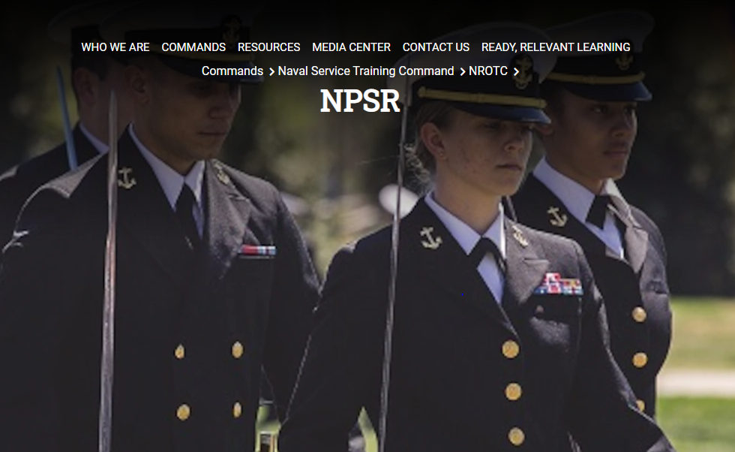
https://www.netc.navy.mil/Commands/Naval-Service-Training-Command/NROTC/NPSR/
Notes:
NPSR is an older title used, “NROTC Preparatory Scholarship Reservations,” and is in process to be changed

Slide 8
NPP Scholarship Reservation Flow Chart
Senior Naval Science Instructor (SNSI)
Publicize and encourage qualified students to apply
NJROTC and NON-NJROTC Applicants
Apply IAW University application processes
NROTC Unit
Coordinate with admission office to review applicants and support NPS selection process (consider medical and alternates)
Request pre-screen of up to 133% of follow-on scholarship cap
University
Select and award one-year full tuition room and board NPS
NROTC Prep Office
Notify university of pre-screen status
Yes
Applicant
Indoc complete or waived
NROTC Prep Office (CC:N92)
Verify drug statement, contract acknowledgement, proof of citizenship, DOBMERB in process and
schedule indoc
Send exclusive scholarship letter to MIDN Candidate
NLT 15 APR to
allow DOBMERB
determination by Aug
NLT 20 Aug
No
No
End
No
Student
Attend and successfully complete university prep program?
Yes
NROTC Unit
Notify N9 of those students successfully completing program
Yes
N9
Successful program completion validated by selection board and send scholarship letter
4-Year
Education &
Professional
Development
Graduation and Commissioning
April 2022
Notes:
Nomination package consists of:
SNSI nomination letter
a. Desired Prep Program/University
b. Last Name, First Name, Middle Initial
c. SSN
d. Gender
e. Date of birth
f. Race and Ethnicity
g. Street Address, City, State, Zip code
h. Email address
i. High School, City, State
j. Optional data: Intended Major/Tier
K: Recommendation paragraph
NROTC SOU
NROTC Drug statement
NROTC Debarment statement
Applicant Fitness Assessment (AFA)
Proof of citizenship

Slide 9
NPP Results
Of 426 students who started NPP, 72.77.% complete the preparatory year as of 1APR23
Of 207 NPP students who have received NROTC scholarships, 71.5% remain in the program
Total students | 426
Male | 268 | 62.9%
Female | 158 | 37.1%
Native American | 9 | 2.1%
Asian | 29 | 6.8%
Black | 94 | 22.1%
Pac. Island | 2 | .5%
White | 236 | 55.4%
Hispanic | 95 | 22.3%
Notes:
13 respondents (4.3%) declined to respond.
23 respondents (7.6%) claim multiple racial designations.
Respondents who claim Hispanic ethnicity also claim another racial designator.

